Slide 1
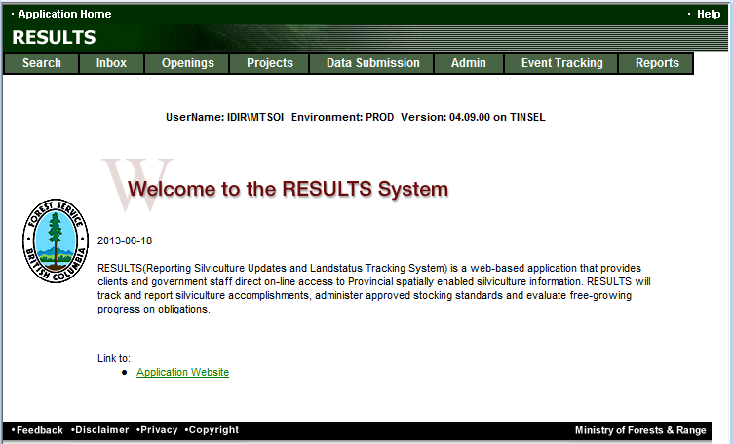
RESULTS Training
Core Module 1
Obligation Reporting
Policy and Business Context
Sept 2013

Slide 2
Learning Objectives
Legislation reference
Form and Manner for Reporting
Business documentation
Opening lifecyle and reporting frequency
Getting RESULTS Access
Help resources

Slide 3
Legislation References
Forest Practices Code of BC Act
  69.1 Reforestation for areas under a site plan
  s.70 Silviculture prescriptions
  s.71 Silviculture prescriptions for non-replaceable licences
Timber Harvesting and Silviculture Practices Regulation
  s.35 Requirements for areas under a site plan
  s. 36 Areas under a site plan without regeneration objectives
  s.45 Reporting requirements for areas without regeneration objectives
  s.46 Format and timing of reporting
  s.47 Minister may establish requirements
  s.48 General mapping requirements
  s.49 Limitation of liability of persons to government (declarations)

Slide 4
Legislation References
Forest and Range Practices Act
  s.29 Free growing stands
  s.30 Free growing stands for non-replaceable licences
  s.107 Limitation of liability of persons to government (declarations)
  s.108 Government may fund extra expense or waive obligation
Forest Planning and Practices Regulation
  s.34 Content of site plans
  s.44 Free growing stands generally
  s.45 Free growing stands collectively across cutblocks
  s.46 Free growing stand – forestry licence to cut
  s.46 .1 Free growing stands – community salvage licence
  s.46.11 Free growing stand requirement applies to each hectare
  s.46.2 Requirements if free growing stand cannot be established
  s.66 Wildlife tree retention
  s.86 Annual reports
  s.96 Relief or funding
  s.97 Declaration of agreement holders and others as to fulfillment of obligations
  s.97.1 Declaration regarding free growing stand obligations met to the extent practicable

Slide 5
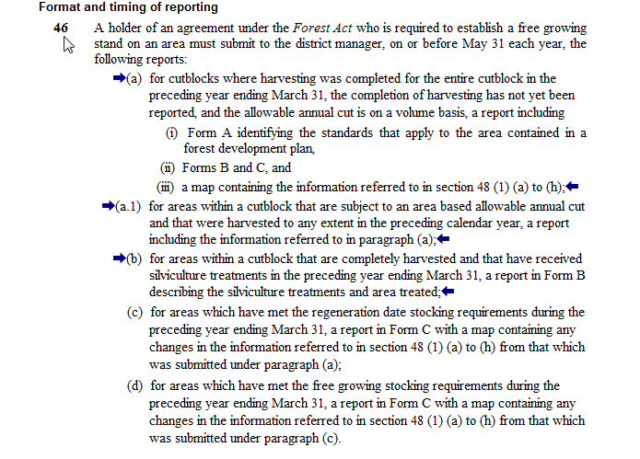
Legislation References – THSPR s.46

Slide 6
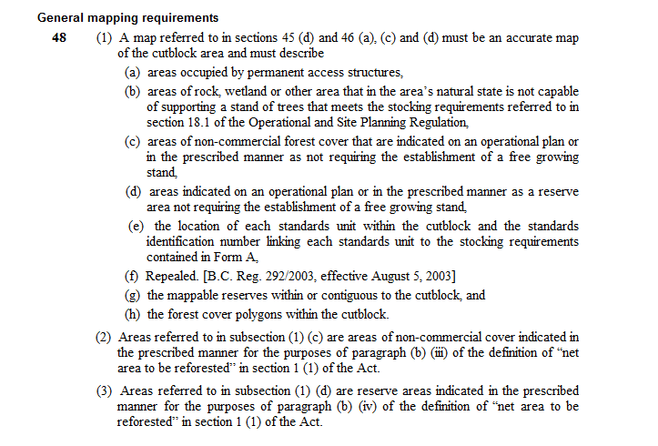
Legislation References – THSPR s.48

Slide 7
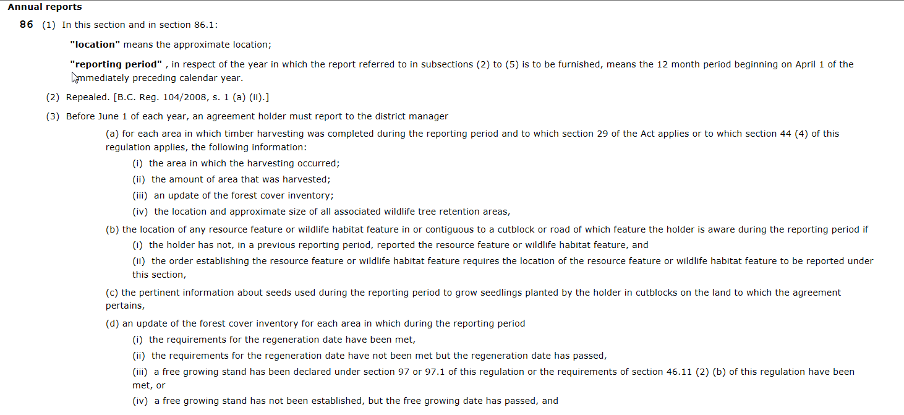
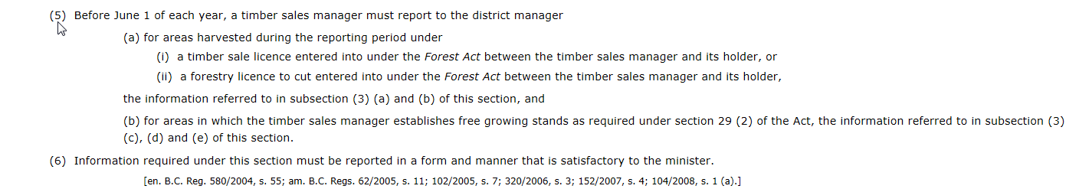
Legislation References – FPPRs.86

Slide 8
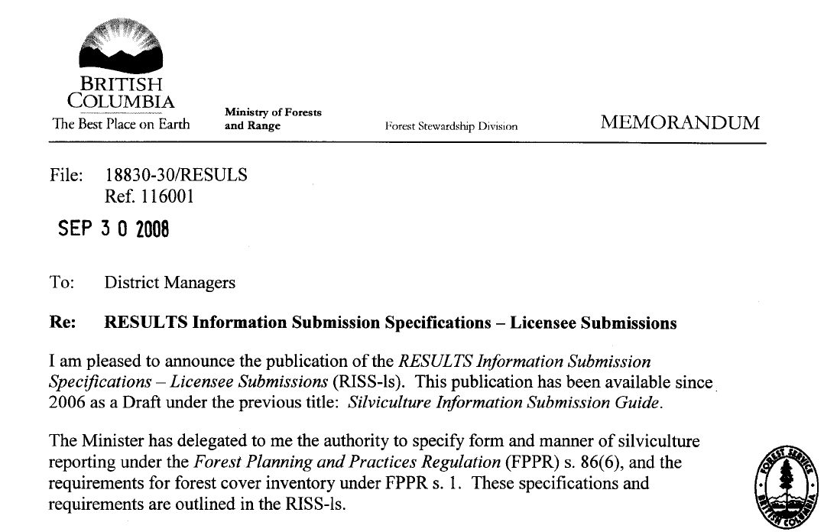
Form and Manner for Reporting
FPCBC Timber Harvesting and Silviculture Practices Reg. s.46 Format and Timing of Reporting
FRPA Forest Planning and Practices Reg. s.86 - Annual Report
Form and Manner for Reporting Specified by Chief Forester

Slide 9
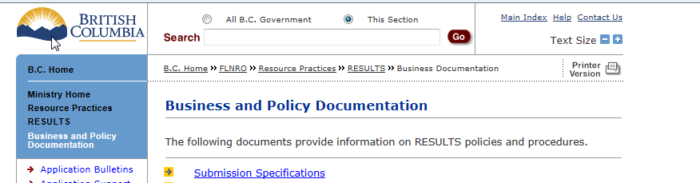
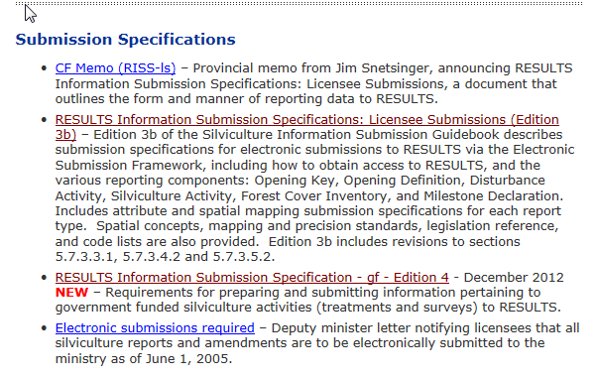
Business Guidance
http://www.for.gov.bc.ca/his/results/business.htm
Core document that details submission requirements

Slide 10
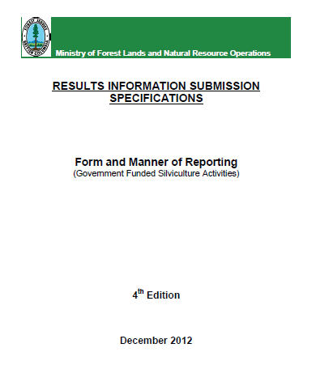
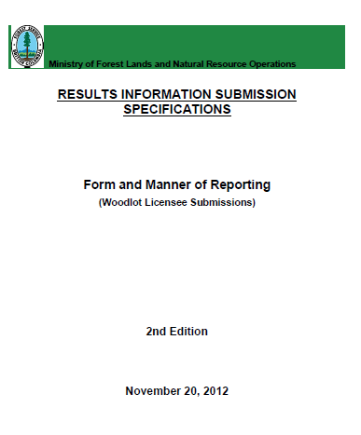
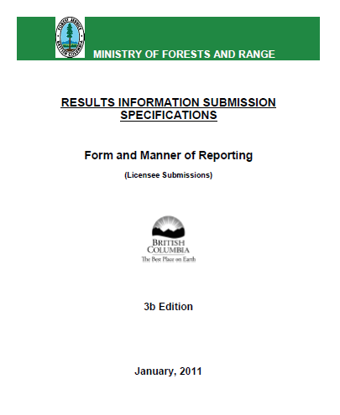
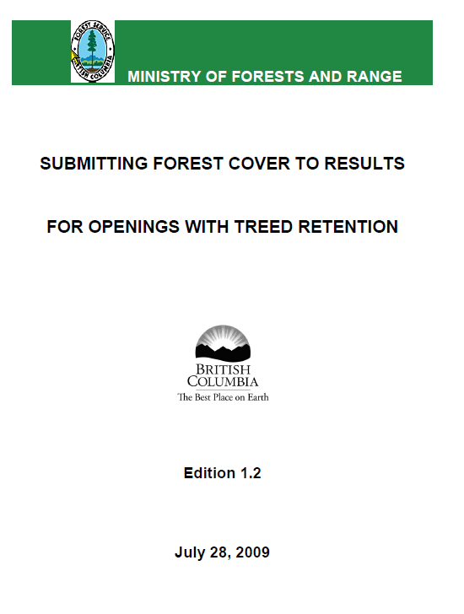

Business Guidance
Other core documents on business requirements link
http://www.for.gov.bc.ca/his/results/business.htm

Slide 11
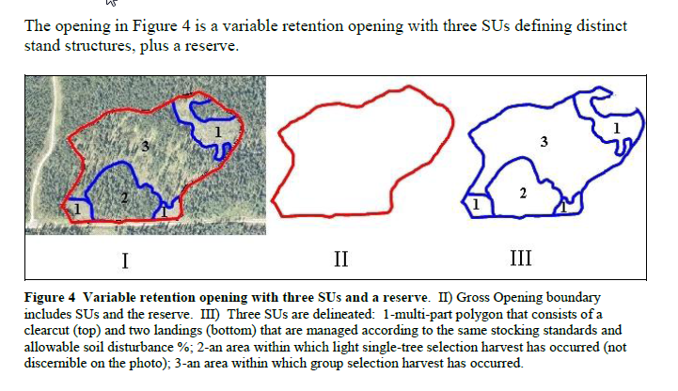
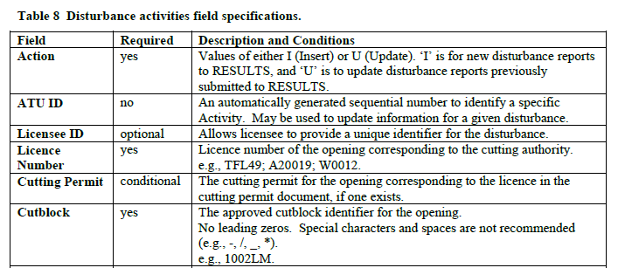
Business Guidance – RISS-licensee submission http://www.for.gov.bc.ca/his/results/RISS_ls_3b_ed_Jan1.pdf
Background on Legislation
ESF Submission
Submission Components
Submission Requirements (Mandatory, Condition, or Optional)
Additional Background and examples

Slide 12

Opening’s Lifecycle - Reporting Frequency
Harvest
Activity
Year 0 thru 20
Opening Definition Disturbance Forest Cover
Upon Harvest Completion on cutblock preceding fiscal year by May 30
Reporting
Item
Timing

Slide 13
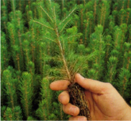
Opening’s Lifecycle - Reporting Frequency
Harvest | Planting
Activity
Year 0 thru 20
Opening Definition Disturbance Forest Cover | Silv Activity
Upon Harvest Completion on cutblock preceding fiscal year by May 30 | Activities completed within fiscal year by May 30
Reporting
Item
Timing

Slide 14
Opening’s Lifecycle - Reporting Frequency
Harvest | Planting | Regen Surveys
Activity
Year 0 thru 20
Opening Definition Disturbance Forest Cover | Silv Activity | Forest Cover Milestone
Upon Harvest Completion on cutblock preceding fiscal year by May 30 | Activities completed within fiscal year by May 30 | Forest Cover before or on Regeneration Due Date
Reporting
Item
Timing

Slide 15

Opening’s Lifecycle - Reporting Frequency
Harvest | Planting | Regen Surveys | Various Activities: BR, JS
Activity
Year 0 thru 20
Opening Definition Disturbance Forest Cover | Silv Activity | Forest Cover Milestone | Silv Activity
Upon Harvest Completion on cutblock preceding fiscal year by May 30 | Activities completed within fiscal year by May 30 | Forest Cover before or on Regeneration Due Date | Activities completed within fiscal year by May 30
Reporting
Item
Timing

Slide 16
Opening’s Lifecycle - Reporting Frequency
Harvest | Planting | Regen Surveys | Various Activities: BR, JS | FG Survey
Activity
Year 0 thru 20
Opening Definition Disturbance Forest Cover | Silv Activity | Forest Cover Milestone | Silv Activity | Forest Cover Milestone
Upon Harvest Completion on cutblock preceding fiscal year by May 30 | Activities completed within fiscal year by May 30 | Forest Cover before or on Regeneration Due Date | Activities completed within fiscal year by May 30 | Forest Cover before or on Late Free Growing Due Date
Reporting
Item
Timing

Slide 17
Reporting responsibility
RESULTS contains legal documents (Standards Unit) representing the licensee’s obligation.
Your responsibility is to :
  Have an understanding of Legal Reporting Requirements
  Have authorization to Report for the Client (Licensee)
  Have sufficient knowledge and training to report to RESULTS
  Ensure that the data provided/submitted is accurate as per submission standard

Slide 18
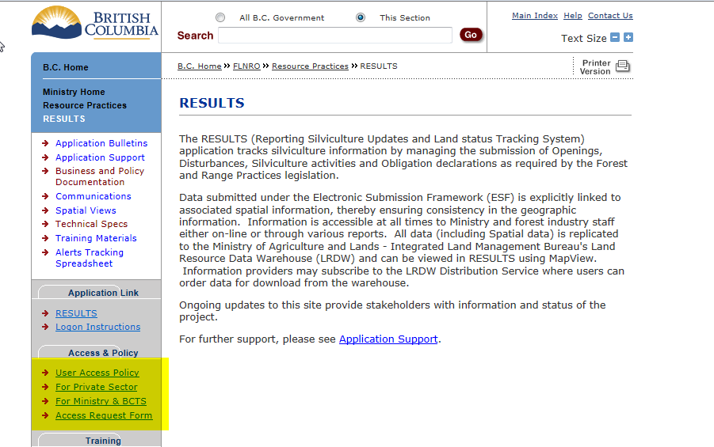
Getting Access to RESULTS
Must have bceid or idir account and then apply via Access Request Form
If submitting for a licensee must be authorized by licensee to act on their behalf

Slide 19
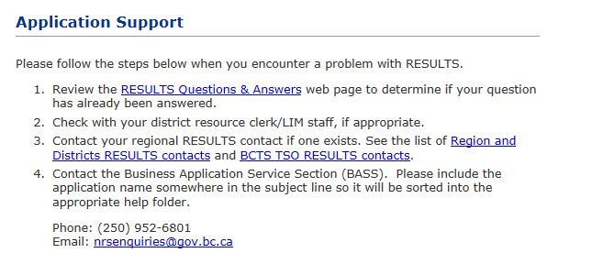
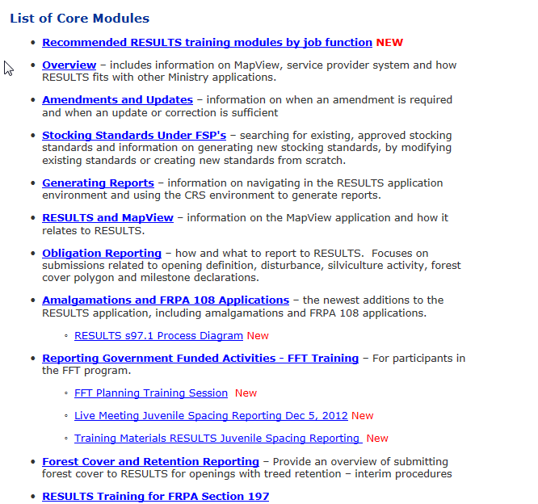
Help Resources
http://www.for.gov.bc.ca/his/results/support.htm
http://www.for.gov.bc.ca/his/results/training/index.htm
E-Stand Enhancement

